Slide 1

How to Register using
MyLeo

Slide 2
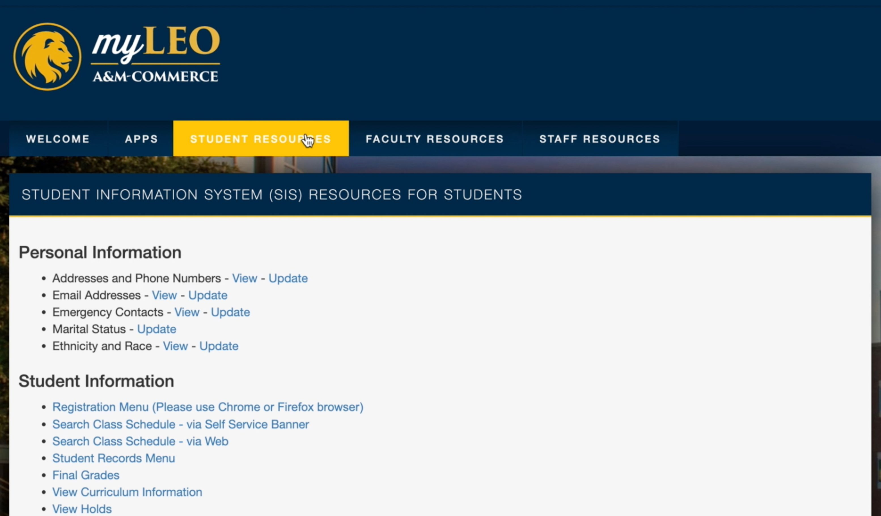

Select : Student Resources

Slide 3
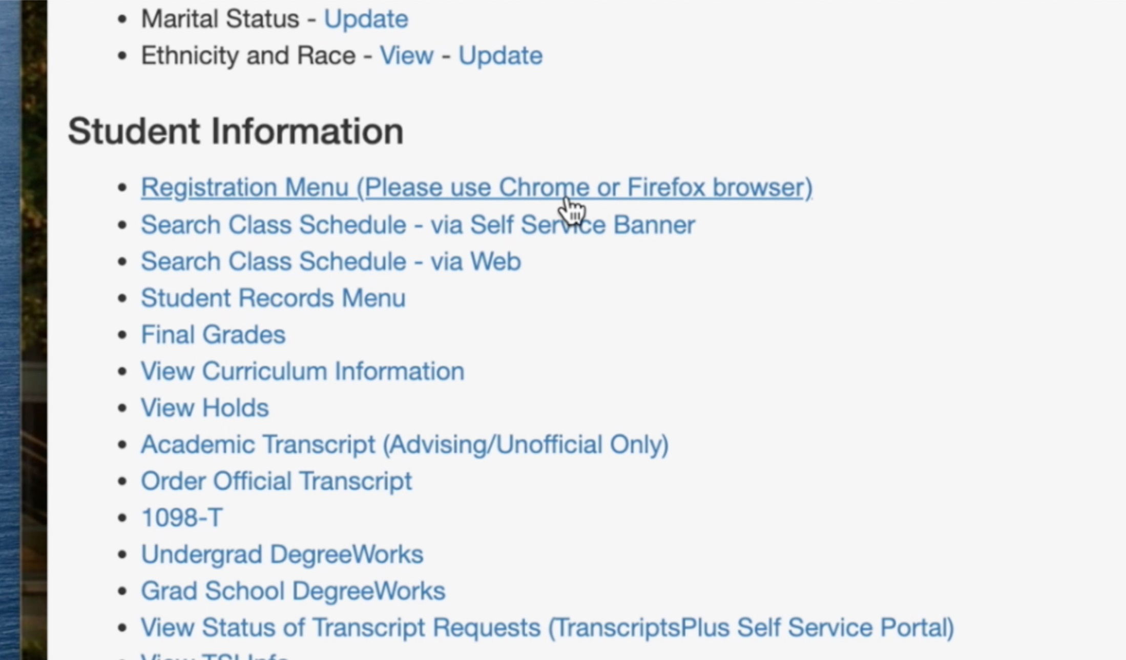
Select: Registration Menu

Slide 4
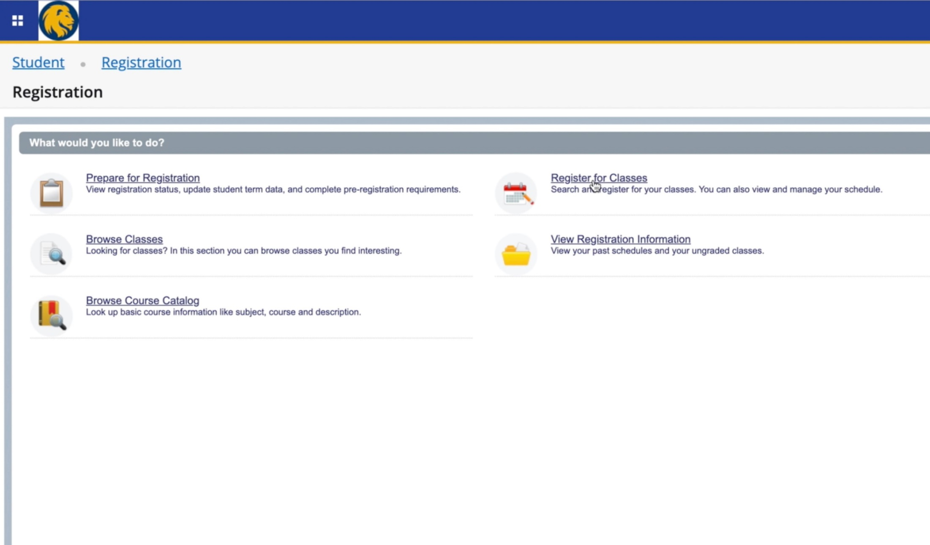
Select: Register for Classes

Slide 5
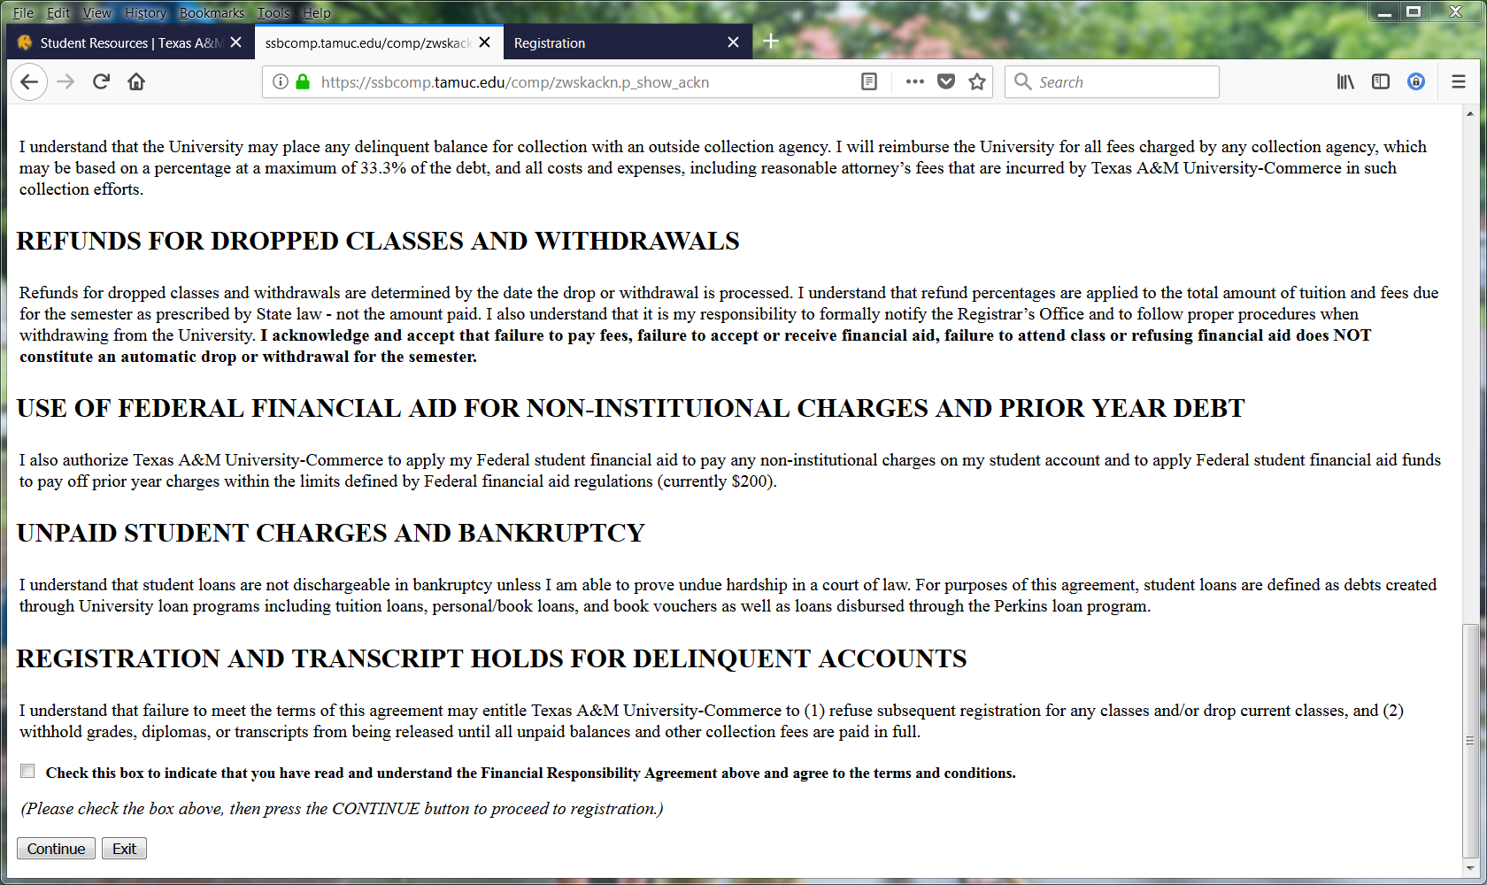
Accept your financial agreement

Slide 6
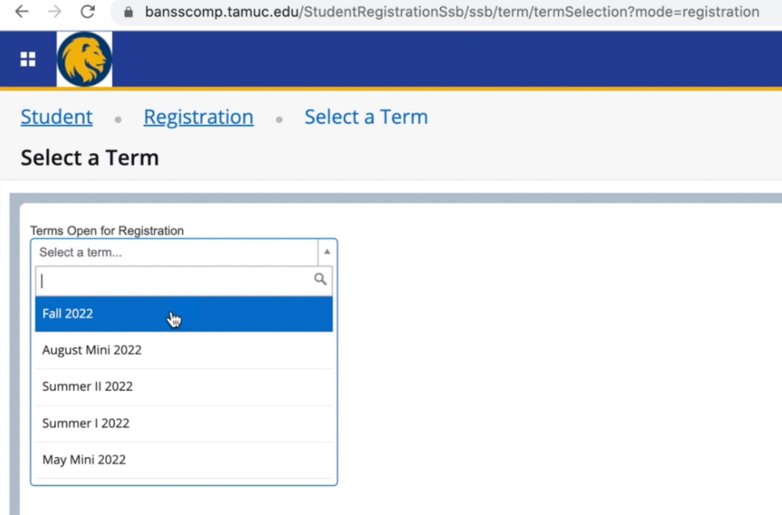
Selecting the Term
Use the drop down box to
select the term you would like to register for, then click the
SUBMIT button.

Slide 7
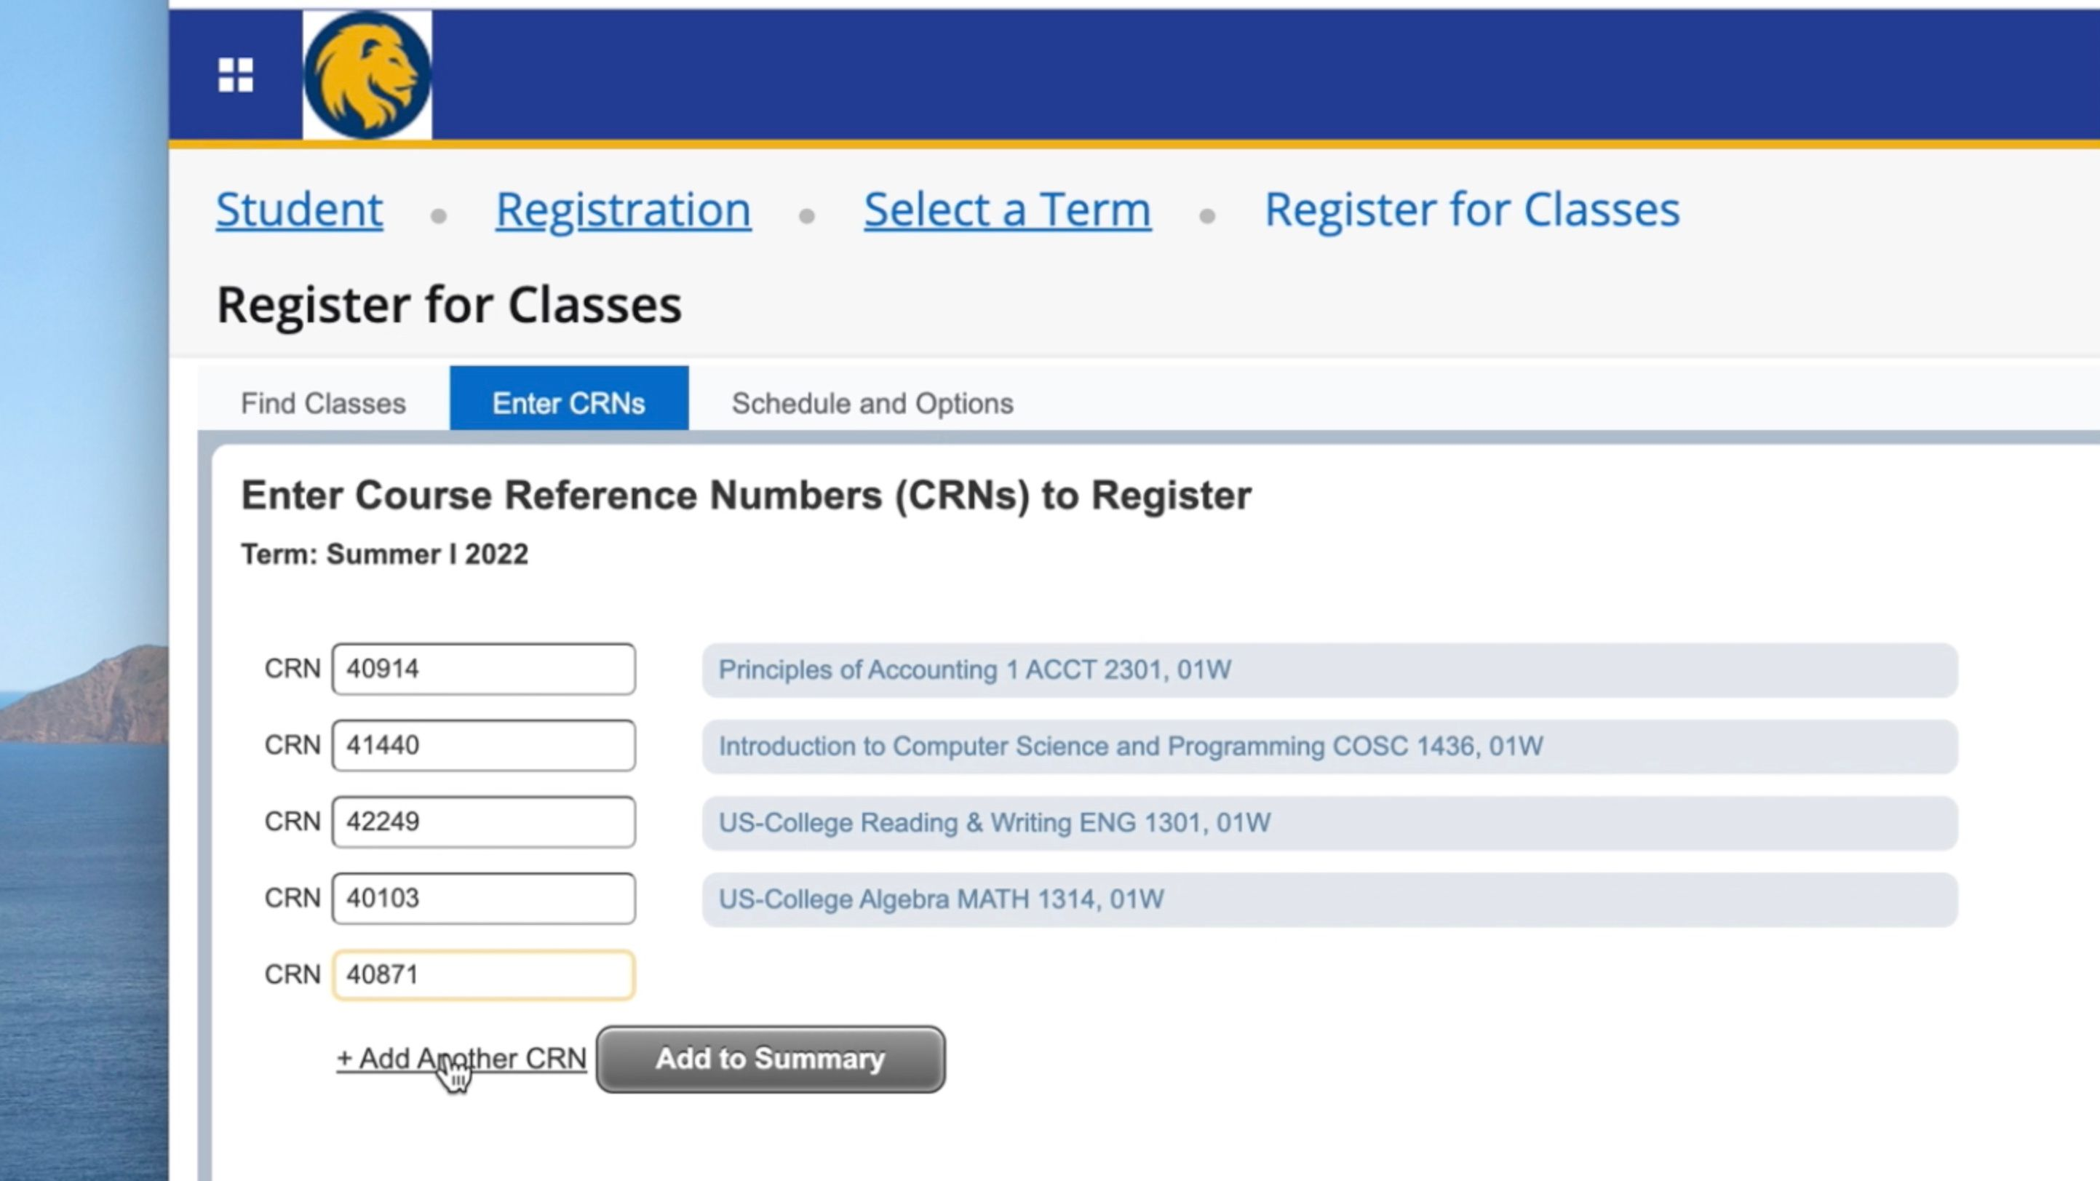
Enter Information
Add the Course Reference Number (CRN)
for each class in the spaces provided
If you need to search for a class use the
Find Class button or view the schedule of classes at
www.tamuc.edu/schedule
When all classes are entered hit
Add to Summary

Slide 8
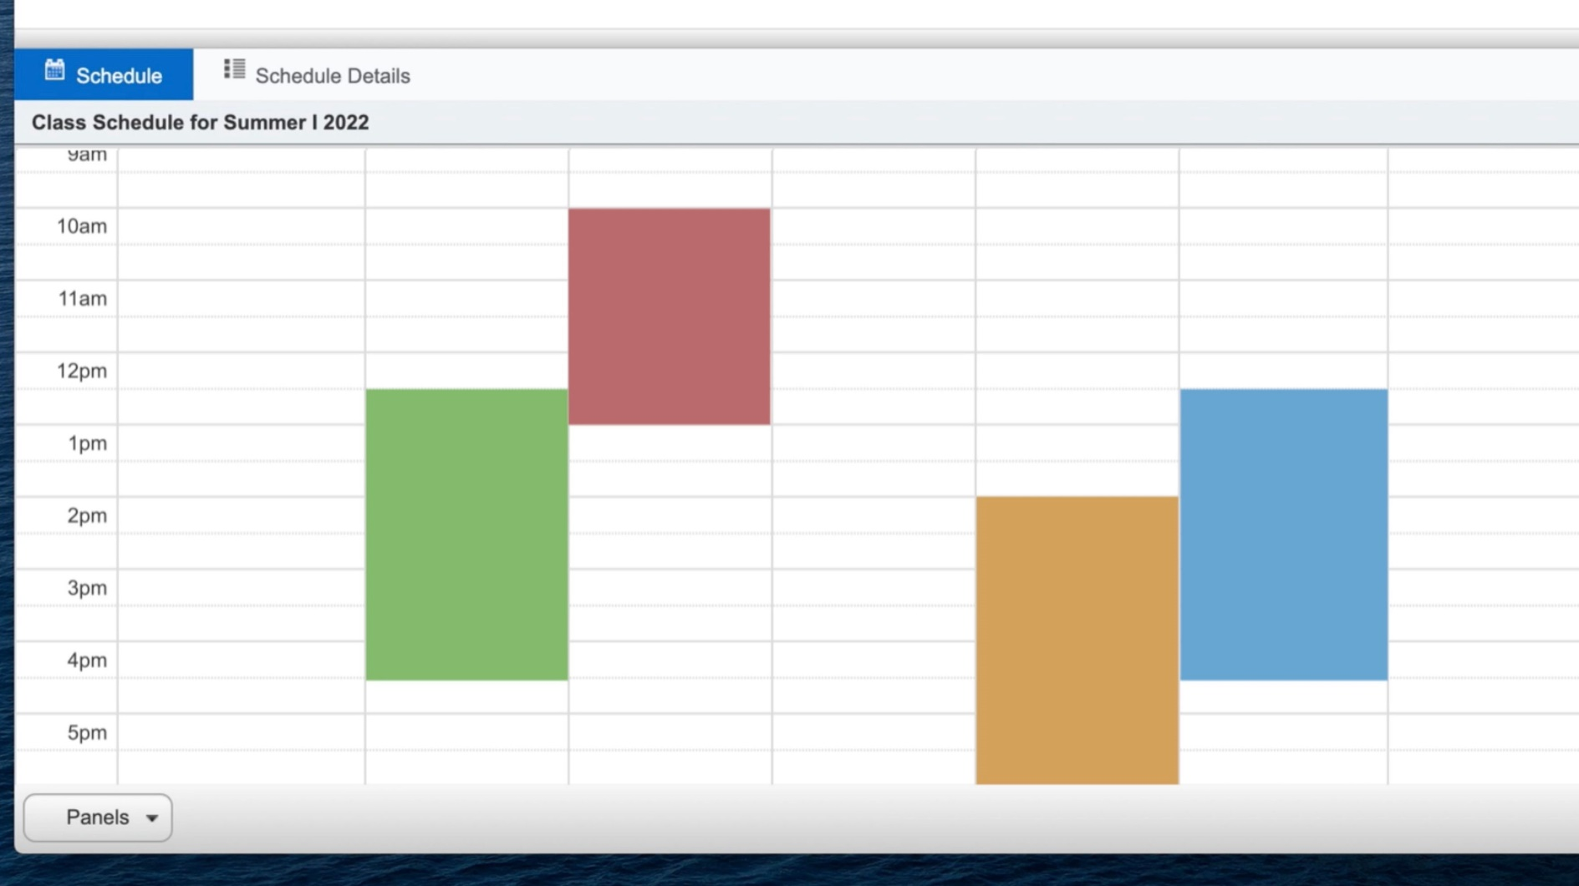
Final Schedule
Schedule of Classes
(bottom left corner of the screen)

Slide 9
Things to Remember
Check your MyLEO e-mail often.
Check your week at a glance or schedule detail after registering.
If you have any questions please contact the Registrar’s Office at 903-886-5068.

